Slide 1
BGP Explained

Slide 2
What BGP Is and Is Not
Path vector routing protocol
Aids in loop prevention by not maintain a full topology
Does not advertise incremental updates like OSPF
Uses Autonomous System number
Can’t learn other routers dynamically
Designed to be inter-autonomous
Adjacencies should not change frequently and are coordinated
Neighbors are defined by IP Address

Slide 3
BGP Sessions
A session is an established adjacency between two BGP routers
2 types of BGP sessions
IBGP
A session with an IBGP router within the same AS
EBGP
A session established with a router in a different AS

Slide 4
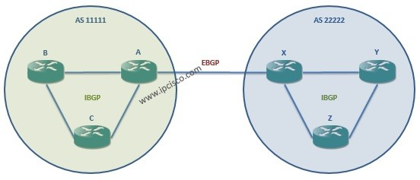
Prac App
Draw IBGP and EBGP
Add AS numbers
Add logical connections

Slide 5
Inter-Routing Communication
BGP neighbors connected to the same network use the ARP table to locate the IP address of the peer
BGP can form adjacencies that are directly connected and multiple hops away
Multi-hop BGP sessions require an underlay routing table to provide the topology path information to establish the BGP session
BGP routers don’t have to be in the data plane (path) to exchange prefixes, but all routers in the plane need to know all the routers to forward traffic through them

Slide 6
Configuring BGP
It’s best to think of configuring BGP from a modular perspective
Configuring BGP requires the following components:
BGP Session Parameters
Parameters = “Settings”
Ex of parameters: ASN, Authentication, KeepAlive timers, Source/Destination IP Address
Address Family Initialization
Initialization = enabling
Network advertisement and summarization occur here
Activation of the Address Family on the BGP Peer
Router’s address is added to the neighbor table and BGP session begins to be established

Slide 7
BGP BASIC CONFIGURATION
Step 1: initialize the BGP process
“Router bgp as number”
Step 2: statically define the BGP router ID
“BGP router-id router id”
Step 3: identify the BGP neighbor’s IP address and AS number
“neighbor x.x.x.x remote-as as number”
Step 4: Specify the source interface for BGP session
“neighbor x.x.x.x update-source interface id”
Step 5: Enable BGP authentication (helps prevent spoofing)
“neighbor x.x.x.x password password phrase”
Step 6: Modify BGP timers
“neighbor x.x.x.x timers keepalive holdtime”

Slide 8
Helpful BGP Commands
Task | Command Syntax
Initialize the BGP router process | router bgp as-number
Statically configure the BGP router ID | bgp router-id router-id
Identify a BGP peer to establish a session with | Neighbor ip address remote-as remote-as #
Configure the BGP session timers | Neighbor ip address timers keepalive holdtime
Initialize a specific address family and sub-address family | Address-family afi safi
Activate a BGP neighbor for a specific address family | Neighbor ip address activate
Advertise a network into BGP | Network network mask subnet-mask [route-map route-map-name]
Display the contents of the BGP database | Show bgp afi safi [network] [detailed]
Display a summary of the BGP table and neighbor peering sessions | Show bgp afi safi summary
Display BGP settings w/ peer & # of prefixes exchanged w/ peer | Show bgp afi safi neighbors ip address
Display adj-RIB-out BGP table for a neighbor | show bgp afi safi neighbor ip address advertised routes

